Slide 1
Lifecycle and methodologies in OSS - Open Source Software Development Process Model
Dr. Ritu Arora
Assistant Professor (Off-Campus)
Department of Computer Science & Information Systems
BITS, Pilani

Slide 2
Open Source Software Development Model
OSSD model is different from the traditional Waterfall or Cascading model of software development
The traditional software development model comprises of six activities:
Collecting and analysing requirements
Designing a solution
Developing the code
Testing
Deployment
Maintenance
These activities are arranged in a linear fashion
Work starts on a particular activity only after the previous activity is completed

Slide 3
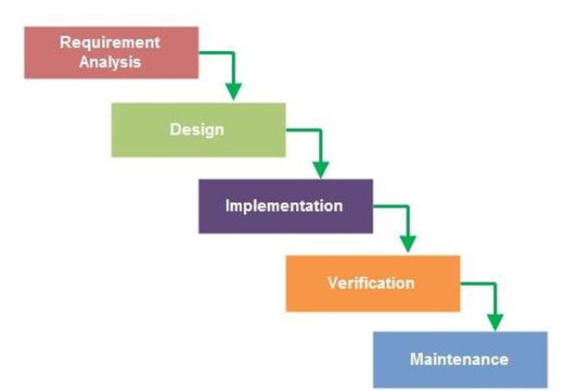
Waterfall Model
Waterfall Model: Linear development model

Slide 4
Open Source Software Development Model
OSSD starts with an idea for a new project, or a new feature or functionality for an existing open source project.
Next step is to create a design for the proposed solution. This step might be followed by creation of an optional prototype (proof-of-concept)
Next step is to convert the proposed idea into a running software by providing implementation for the same
The moment the software runs (partially, mostly), it is released as a development release (even though it may contain known and unknown bugs)
This is in alignment with the philosophy of – “release early, release often”

Slide 5
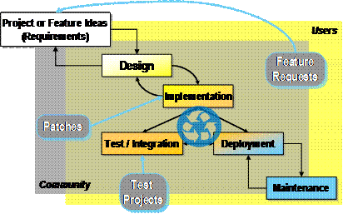
Open Source Software Development Model
(Source: Haddad, Ibrahim, and Brian Warner. "Understanding the open source development model." Linux Journal (2011))

Slide 6
Thank You!
In our next session:
Lifecycle and methodologies in Open Source Software –
Unique characteristics of the Open Source Software Development Process Model

